Slide 1
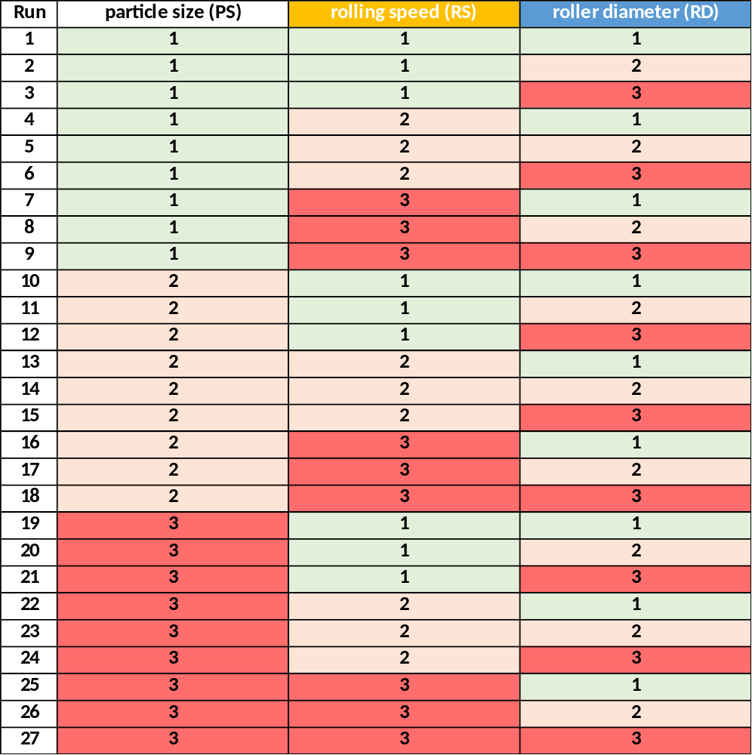
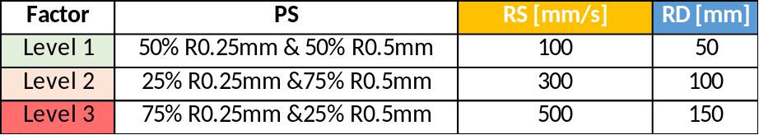
DOE-Parameters for DEM model
Outputs:
Surface Roughness (mm)
Variance Surface roughness (mm)
Solid Fraction
Variance Solid Fraction
Coordinate Number
Variance Coordinate Number

Slide 2
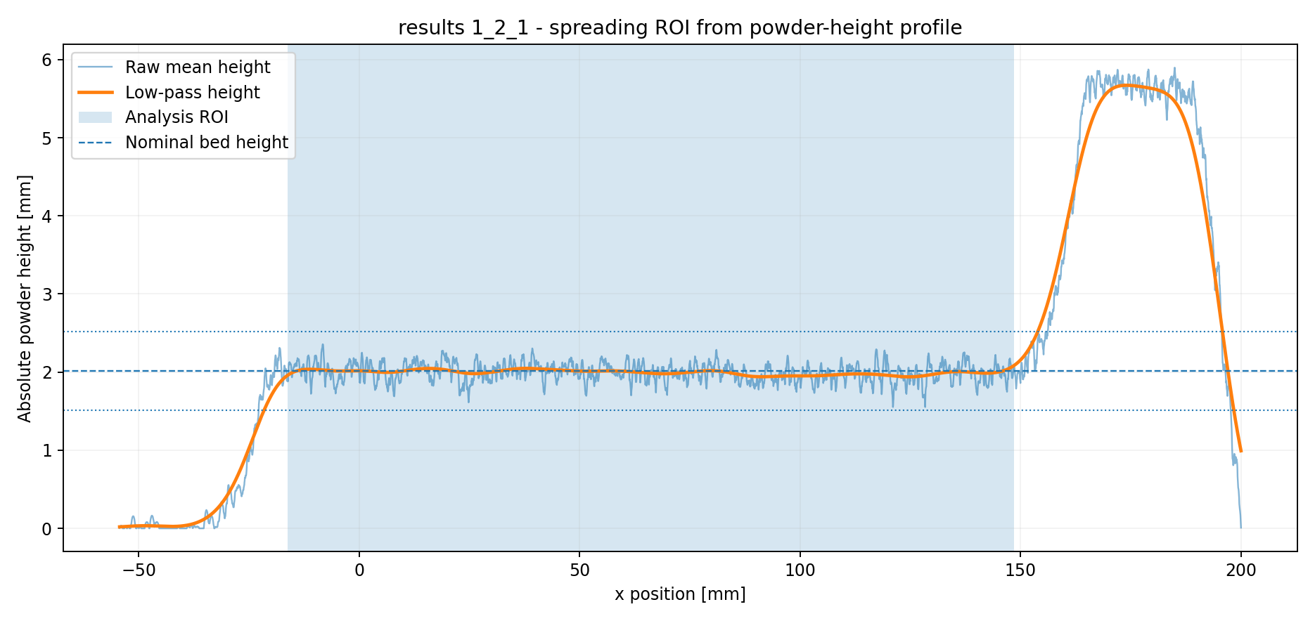
Analysis Region

Slide 3
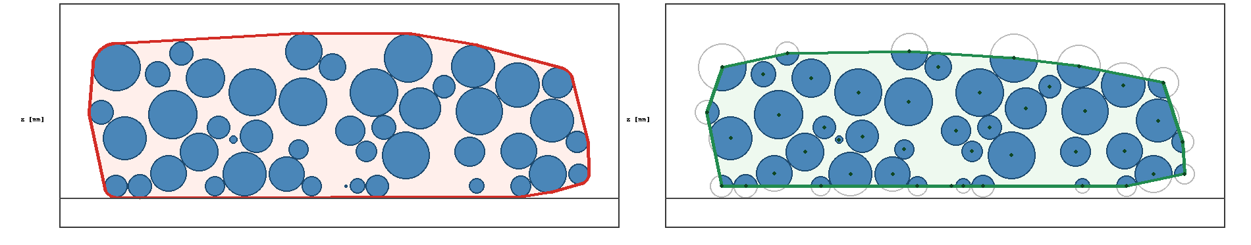
Solid Fraction (unitless)
Convex Hull over the particle centers
  Assume this pattern repeats otherwise solid fraction is much lower
  Outside compute: 0.543
  Center compute: 0.578

Slide 4
Roughness (mm)
Height map in mm
For each transverse direction to spreading (evey pixel column) compute standard deviation in height
Average these to get roughness value
STD(height)
STD(height)
STD(height)
STD(height)
STD(height)
STD(height)
Average(STD)

Slide 5
Metric Comparison

Slide 6
Metric to Variance

Slide 7
Coordinate Number

Slide 8
Coordinate Number Variance

Slide 9
Relative Density (solid fraction)

Slide 10
Relative Density Variance

Slide 11
Surface Roughness

Slide 12
Roughness Variance

Slide 13
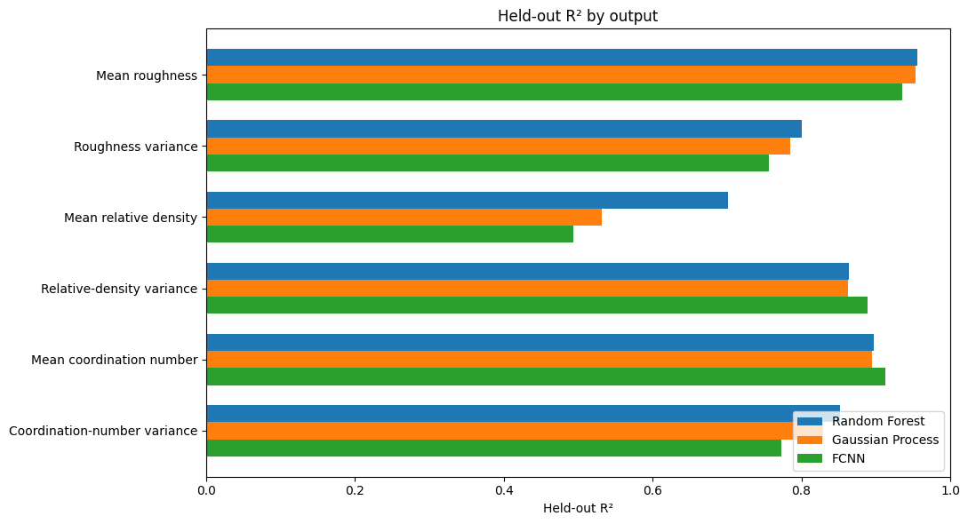
Model Comparison
Using cross-validation
  10% validation holdout
  10% test holdout
  80% training
FCNN overfits on validation
Random forest performs best overall

Slide 14
Model Prediction
Held out performance
Normalized RMSE should be compared to 1 for random predictor
Output | Normalized RMSE | R² | Physical RMSE | Physical MAE
Mean roughness | 0.1924 | 0.9553 | 0.0076 | 0.0061
Roughness variance | 0.4228 | 0.8004 | 0.0007 | 0.0005
Mean relative density | 0.4250 | 0.7013 | 0.0051 | 0.0042
Relative-density variance | 0.3240 | 0.8635 | 0.0002 | 0.0002
Mean coordination number | 0.2972 | 0.8970 | 0.0846 | 0.0584
Coordination-number variance | 0.3927 | 0.8523 | 0.2899 | 0.2203

